Slide 1
LG BOOSTING ALGORITHM

Slide 2
What is LG Boosting
LG algorithm is nothing but the Light Gradient Boosting Machine.
Light GBM is a gradient boosting framework based on decision tree algorithms.
It's designed to be highly efficient, scalable, and fast, especially for large datasets and high-dimensional features.
Key features of LG Boosting
Leaf-wise tree growth
Histogram-based learning
Gradient-based One-Side Sampling
Exclusive Feature Bundling

Slide 3
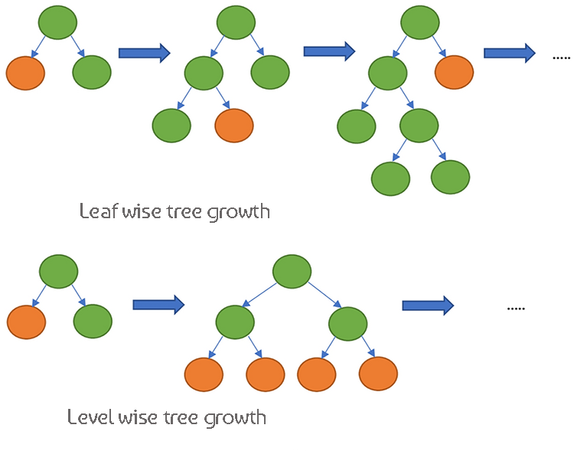
How LG boost works

Slide 4
Use cases of LG boost:
LG boost are mainly used in following fields:
Financial Services
Healthcare
Manufacturing and Predictive Maintenance
Anomaly Detection

Slide 5
Pros and Cons of XG Boosting
Speed and Efficiency
Hardware Flexibility
Flexibility
Feature Importance
Complex Parameter Tuning
Less Mature Ecosystem
Risk of Over fitting
Not Ideal for Small Datasets

